Slide 1
Name
Subject

Slide 2

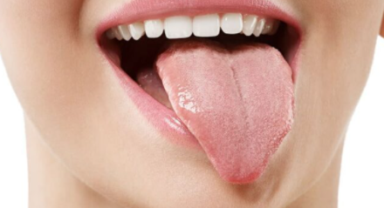
Introduction
The tongue is a unique organ that is located in the oral cavity.
It not only facilitates perception of gustatory stimuli but also plays important roles in mastication and deglutition (Tasko, S. M., Kent, R. D., & Westbury, 2002).
To add on, the tongue is an integral component of the speech pathway, as it helps with articulation.

Slide 3
Structure of the Tongue
The human tongue is about 3.3 inches in men and 3.1 inches in women. It is located in the oral cavity.
The tongue is divided into three parts:
Tip
Body
Base
The tongue is embryologically divided into the anterior and posterior part. The anterior part is known as the oral or presulcal part that includes the root attached to the floor of the oral cavity. While the posterior part is known as pharyngeal or postsulcal part that includes the base forming the ventral wall of oropharynx.

Slide 4
Cont.
Three elements make up the tongue;
Epithelium - The surface of the tongue is covered by stratified squamous epithelium, modified on the upper surface into filiform papillae.
Muscles - The tongue is a muscular organ situated in the oral cavity, and an accessory digestive organ. Its main functions include sensation of taste, mastication (chewing), deglutition (swallowing), speech, and clearing the oral cavity.
Glands:
parotid glands produce a serous, watery secretion.
submaxillary (mandibular) glands produce a mixed serous and mucous secretion.
sublingual glands secrete a saliva that is predominantly mucous in character

Slide 5
Epithelium
The epithelium comprises papillae and taste buds.
The taste buds help to sense taste.
They are lined by squamous epithelial tissue and have a broad bottom.
The taste cells are slender, rod-shaped with a nucleus in the center.
The free surface comprises short taste hair.
The taste cells help in detecting taste, which dissolves in saliva for proper sensation.

Slide 6
Cont.
Muscles
Glands
The tongue muscles are voluntary and contain cross-striated muscular fibers.
Skeletal muscle – covered by mucous membrane that keeps the tongue moist.
The tongue consists of small and scattered glands. These glands are of three types:
Mucous Glands
Serous Glands
Lymph Nodes
The lymph nodes are very prominent at the posterior part of the tongue and are known as lingual tonsils.

Slide 7
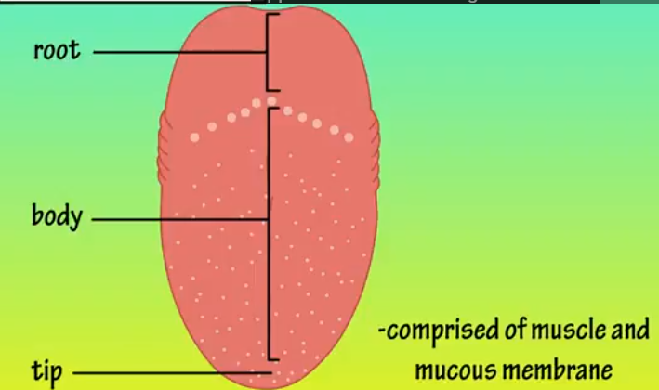
Cont.
The tongue has a root, a tip, and a central body to its structure.
The upper surface of the tongue is covered by small rough elevations called papillae.
Papillae are of 4 types: fungiform, circumvallate, filiform, and foliate (Witt, & Reutter, 2015). .

Slide 8
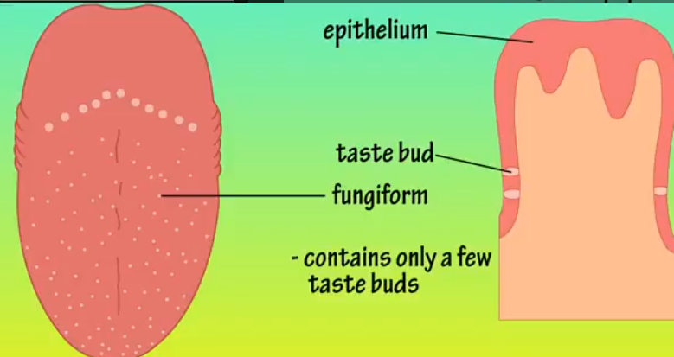
Fungiform papillae
They are mushroom-shaped bumps found near the tip and sides of the tongue (Witt, & Reutter, 2015).
Each of them contains a few taste buds

Slide 9
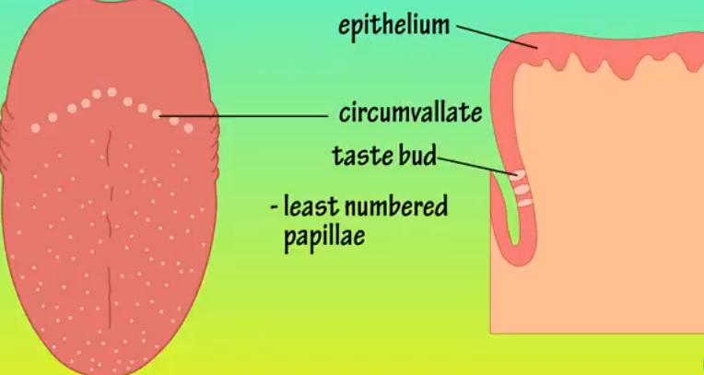
Circumvallate papillae
These are large and dome-shaped
They are the least number of papillae – usually between 10-12 on a tongue and they altogether form a V-shape (Witt, & Reutter, 2015).
Each circumvallate papillae is housed by a deep narrow depression.
The contain thousands of test buds.

Slide 10
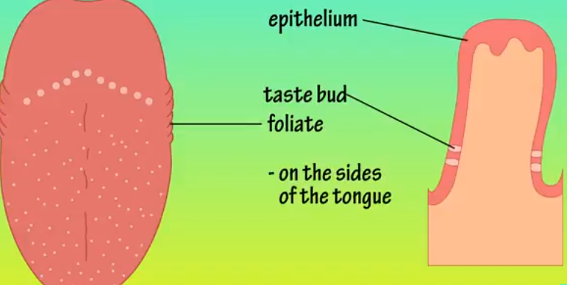
Foliate papillae
Are leaf shaped
Found on the sides of the tongue toward the root
They house hundred or so taste buds (Witt, & Reutter, 2015).

Slide 11
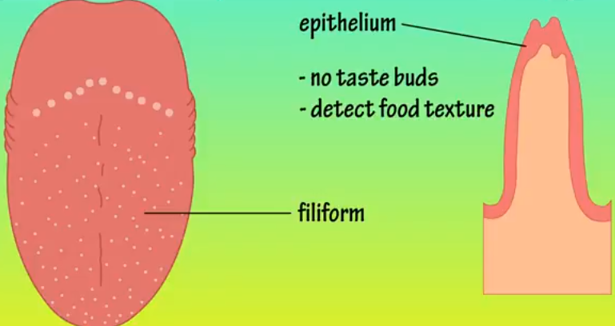
Filiform Papillae
They are short and spiked and are scattered among the fungiform papillae
They don’t house taste buds since they help detect food texture

Slide 12
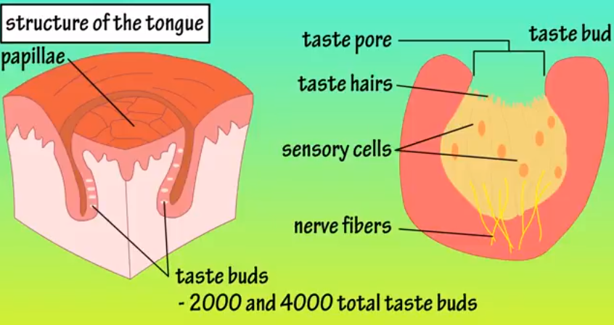
Taste Buds
Taste buds are located in the walls and groves of papillae
Most adults have between 2,000 and 4,000 taste buds in total
They consist of taste poor sensory cells, taste hairs, and nerve fibers

Slide 13
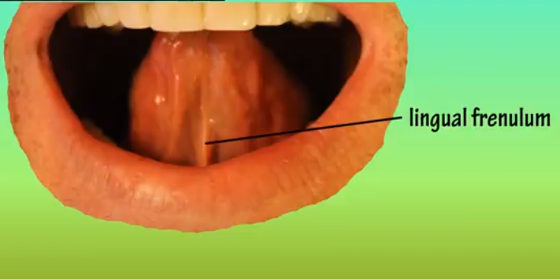
Lingual frenulum
Under the bottom side of the tongue, there is a lingual frenulum
It helps anchor the tongue to the floor of the mouth

Slide 14
Hyoid bone
At the back of the mouth, the tongue is anchored to this bone
The movements and shape changes of the human tongue occur in a space whose dimensions are dictated by movements of the jaw and hyoid.
Tongue behavior cannot be divorced from hyoid movement, which is directly linked to motion of the mandible.
The length and angulation of the floor of the mouth on which the tongue body rides are dictated by that linkage.
Movements of the tongue surface can occur independently of hyomandibular movement within a limited range of jaw motion.

Slide 15
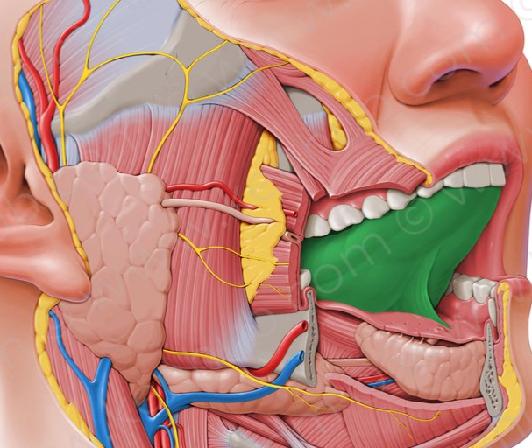
Anatomy of the tongue
The tongue is the most important articulator of speech.
In speaking, changes in tongue shape occur with relatively little jaw movement and so little change in the gross spatial position of the tongue.
The jaw and tongue, therefore, have more independence during speech.
While much is known about movement direction and associated tongue shape in both feeding and speaking, tongue kinematic data are limited.

Slide 16
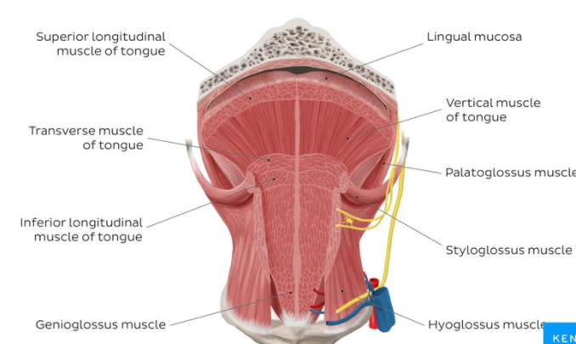
Muscles of the tongue
The tongue is a muscular organ
There are two groups of muscles associated with the tongue
Intrinsic muscles – they alter the tongue’s shape. They are superior longitudinal, inferior longitudinal, transverse and vertical muscles.
Extrinsic muscles – they include genioglossus, hyoglossus, styloglossus and the palatoglossus muscles.

Slide 17
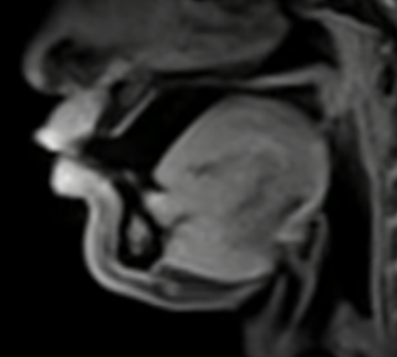
Movements while speaking
In speaking, changes in tongue shape occur with relatively little jaw movement and so little change in the gross spatial position of the tongue.
The jaw and tongue, therefore, have more independence during speech.
Look the picture aside

Slide 18
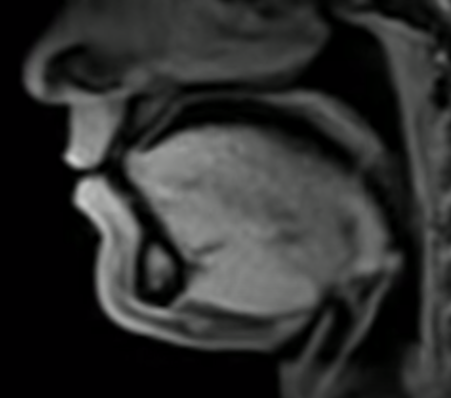
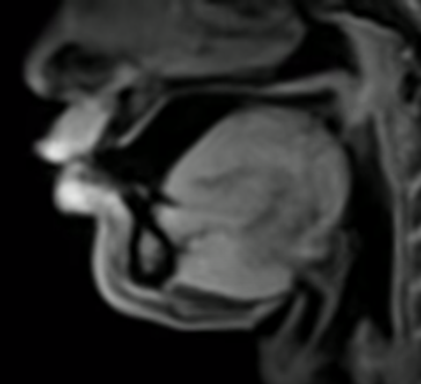
Different images of the tongue as one speaks

Slide 19
Tongue when speaking
When speaking, the tongue relaxes up and forward, the opposite of swallowing.
The quick movements of the tongue, necessary for rapid delivery of tongue twisters for example, require very delicate control of the action of the tongue.
This control is often best regulated in concert with the ear, listening to the sounds created by the voice when the tongue is in one position over another.

Slide 20
Phonetics – Sound Science
Sounds are classified based on voicing. They can, therefore, be voiced or voiceless.
Classification | Voiced/Voiceless
Bilabial (two lips) lower lip and upper lip. A bilabial sound is produced by using both lips pressed together. | This produces three different English sounds: [p] voiceless [b] voiced [m] voiced
Labiodental (lips and teeth) lower lip/upper teeth. A labiodental sound is produced by placing the upper teeth on the lower lip. | There are two labiodental sounds in English:[f] voiceless [v] voiced
Interdental (between the teeth) tongue, upper, and lower teeth. An interdental sound is produced by putting the tip of the tongue between the upper and the lower teeth. | Two sounds in English are Interndental sounds:[θ] voiceless (thin) [ð] voiced (then)

Slide 21
Dental (teeth) tongue tip and upper teeth A dental sound is produced by placing the blade of the tongue on the back side of the upper teeth. | Dental sounds are not typical of American English.
Alveolar (the alveolar ridge) tongue tip and alveolar ridge An alveolar sound is produced by placing the tongue tip on or just in front of the alveolar ridge (the bump behind the upper teeth). In the case of [ɹ] the tongue tip is close to but not actually touching the alveolar ridge. | There are several sounds in English that are alveolar sounds[d] voiced: [z] voiced [l] voiced [n] voiced [ɹ] voiced [t] voiceless [s] voiceless
Palatoalveolar (hard palate and alveolar ridge) tongue blade and hard palate. These sounds are also called alveopalatal or post alveolar. A palatoalveolar sound is produced by placing the tongue blade close to the hard palate behind the alveolar ridge. The tongue tip may feel as if it is just barely behind the alveolar ridge. | There are two palatoalveolar sounds in English: [ʃ] voiceless (shin) [ʒ] voiced (azure)

Slide 22
Palatal (hard palate) tongue body and hard palate A palatal sound is made by bringing the tongue body up close to the hard palate. | English has one clear palatal sound [j] voiced (you) Some linguists and textbook authors consider the [ʃ] and [ʒ] palatal, not palatoalveolar.
Velar (velum or soft palate) tongue back and soft palate. A velar sound is produce by bringing the tongue back up close to or incontact with the soft palate. | There are three velar sounds in English: [k] voiceless [g] voiced [ŋ] voiced (sing)
Uvular (uvula, the thing that hangs down in the back of your throat) tongue back and back end flap of soft palate. A uvular sound is produced by bringing the tongue back in contact with the uvula | There are no uvular sounds in English, but German, French, and Arabic all have some: [ʁ] German pronunciation for r, French pronunciation for r, Arabic pronunciation for the letter ghain

Slide 23
Pharyngeal (pharynx) tongue root and back of pharyngeal wall A pharyngeal sound is made by bringing the tongue root close to the back of the throat. | There are no pharyngeal sounds in English, but Arabic has some. [ħ] in Arabic is a kind of h sound that seems like you are steaming up your glasses to clean them.
Glottal (vocal folds) A glottal sound is produced by moving the vocal folds. | English has two glottal sounds. The second sound has no letter to represent it because it is a sound of silence. [h] voiceless [ʔ] voiceless (the break between the syllables of uh-oh)

Slide 24
References
Sawczuk, A., & Mosier, K. M. (2001). Neural control of tongue movement with respect to respiration and swallowing. Critical Reviews in Oral Biology & Medicine, 12(1), 18-37.
Tasko, S. M., Kent, R. D., & Westbury, J. R. (2002). Variability in tongue movement kinematics during normal liquid swallowing. Dysphagia, 17(2), 126-138.
Witt, M., & Reutter, K. (2015). Anatomy of the tongue and taste buds. Handbook of olfaction and gustation, 637-664.

